Slide 1
Work life balance and gender equality
The Trade Union Perspective
ETUC
Claudia Menne

Slide 2
EURO BAROMETER 2013

Slide 3
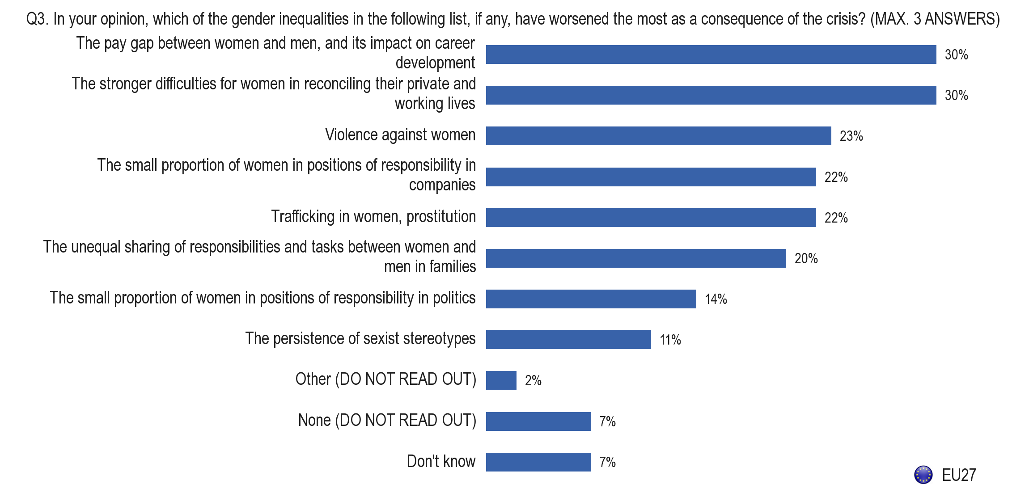
EUROBAROMETER 2013

Slide 4
EUROBAROMETER 2013

Slide 5
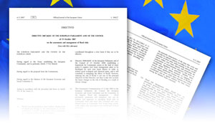


Achievements in the context of EU Social Dialogue
EU SD
Framework agreements on parental leave
1996 + 2010
Autonomous agreement on telework
2002
A toolkit on gender equality
Framework of actions on gender equality
(4 priorities)
Notes:
5

Slide 6
A choice of policy
Scenario: Structural change
The ‘standard worker’ is a worker who (also) cares….in various degrees throughout the life course
Careers are flexible, with alternating periods of high work intensity and lower work intensity
Work organizations are responsive to change and diversity
It is a public interest to invest in an environment that supports and facilitates the (private) choice to have children, and combine paid work with care

Slide 7


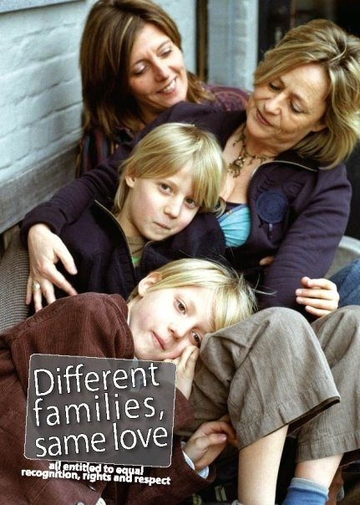
We need new images!

Slide 8
ETUC immediate demands
Policy coherence – NO to AUSTERITY
Gender dimension in the EU Semester
Revision of Gender pay gap Directive
Adopt a Directive on Paternity Leave
Ensure that Barcelona objectives are reached

